Slide 1

Distributed & Cloud Computing
Week – 06 Lectures
BS – CS - VIII

Slide 2
Recap
Why Cloud Computing?
What is Cloud Computing?
Five Key Cloud Characteristics
Deployment Models
Service Models

Slide 3
Service Level Agreement (SLA)

Slide 4
Service Level Agreement
What is Pricing of Cloud Providers
Shifting from own PC to Cloud Services
Assuming: same performance, security, services, etc
Need some agreements
No standard formats of SLAs
Signoff agreements

Slide 5
What is Service Level Agreement?
A formal contract between Cloud service provider and service consumer
SLA: foundation of the consumer's trust on provider
Purpose: to define a formal basis for performance availability guarantees to deliver
SLA contains SLOs
Measureable Objectives and condition for services
SLA & SLO: basis for selection of cloud provider

Slide 6
SLA Contents
Set of service provider will deliver
A complete, specific definition of each service
Responsibilities of provider and consumer
Set of metrics to measure weather provider is offering services as guaranteed
An auditing mechanism to monitor services (may be third party)
Remedies available to consumer and provider if terms violated (penalty)
How SLA will change over time

Slide 7
Types of SLA
Present market place features two types of SLAs:
Off-the-shelf or non-negotiable or Direct SLA
Non-conducive for mission-critical data or applications
provider creates the SLA template and define all criteria
For example: contract period, billing, response time, availability etc.
Followed by the present clouds
Negotiable SLA
Negotiation via external agent
Negotiation via multiple external agents

Slide 8
Service Level Objectives (SLOs)
Objectively measurable conditions for service
Encompasses multiple QoS parameters, i.e. availability, serviceability, billing, penalties, throughput, response time, etc.
Example:
Availability of service X is "99.9%"
Response Time of database query Q is between 3 to 5 seconds
Throughput of a server S at peak load time is 0.875

Slide 9
Service Level Management
Provider perspective:
Make decisions based on business objectives and technical realities
Consumer perspective:
Decisions about how to use cloud services

Slide 10
Consideration for SLA
Business Level Objectives:
Consumers know why using cloud and how to use cloud computing
Responsibilities of the Provider and Consumers:
Balancing both according to type of service
Business Continuity and Disaster Recovery:
Cloud provider have adequate protection in case disaster
System Redundancy:
Any failure (HDD, server, network, etc.) consumers will not experience any outages

Slide 11
Consideration for SLA (Cont..)
Maintenance:
Maintenance of infrastructure affects services
Failure of the provider:
Financial health of provider and contingency plans
Jurisdiction:
Understand laws that apply to any cloud provider

Slide 12

SLA Requirements
Security:
What security requirement and what provider will provide
Data Encryption:
Details of encryption and access control policies
Privacy:
Isolation of customer data in a multi-tenant
Data retention and deletion:
Some providers have legal requirements of retaining data even consumer deleted.
Hardware Erasure and Destruction:
Zero out memory if consumer powers off the VMs or zero out platters of a disk, etc.

Slide 13

SLA Requirements (Cont….)
Regulatory compliance:
If regulations are enforced on data and applications, the providers should be able to prove compliance
Transparency:
For critical data, providers notifying consumers when terms SLA breached
Certification:
Provider responsible in proving certification
Monitoring:
Eliminate conflict of interest between provider and consumer
Auditability:
SLA should make it clear how audits of system take place in case of breached

Slide 14
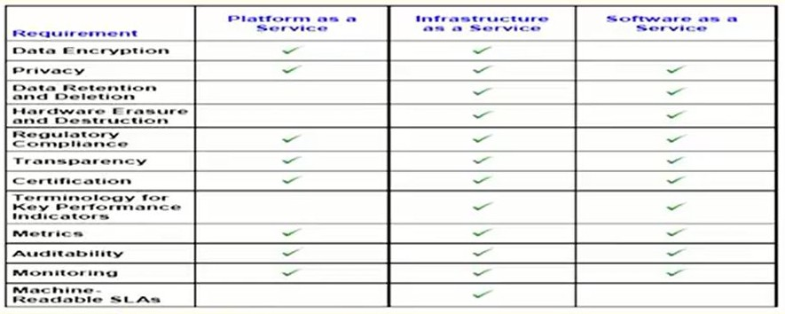
SLA Requirements (Cont….)

Slide 15

Key Performance Indicators (KPIs)
Low-level resource metrics
Multi KPIs are composed, aggregated, or converted to for high-level SLOs
Example:
Downtime, uptime, inbytes, outbytes, packet size, etc.
Possible mapping:
Availability(A) = 1- (downtime/uptime)

Slide 16

Industry-defined KPIs
Monitoring:
Natural questions:
"who should monitor the performance of the provider?"
"does the consumer meet its responsibilities?"
Solution: neutral third-party organization to perform monitoring

Slide 17
Metrics for Monitoring and Auditing
Throughput
How quickly the service responds
Availability
Percentage of uptime of service
Reliability
How often the service is available
Load balancing
Elasticity kicks (new VMs boots or terminated)
Durability
How likely the data is to be lost
Elasticity
The ability for a given resource to grow infinity,
Linearity
How system performs as the load increases

Slide 18
Metrics for Monitoring and Auditing (Cont…)
Agility
Provider responds as consumer's resource load scales up and down
Automation
Percentage of requests handled without any human interaction
Consumer service response times
Provider responds to a service request
Service-level violation rate
Mean rate of SLA violation
Transaction time
Time elapsed from when a service invoked till completion
Resolution time
Time period between detection of problem and resolution

Slide 19
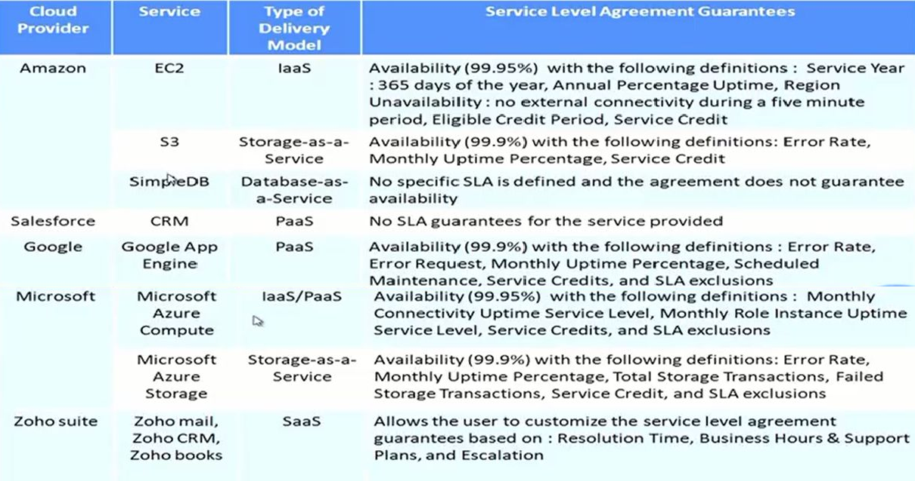
Examples Cloud SLAs

Slide 20
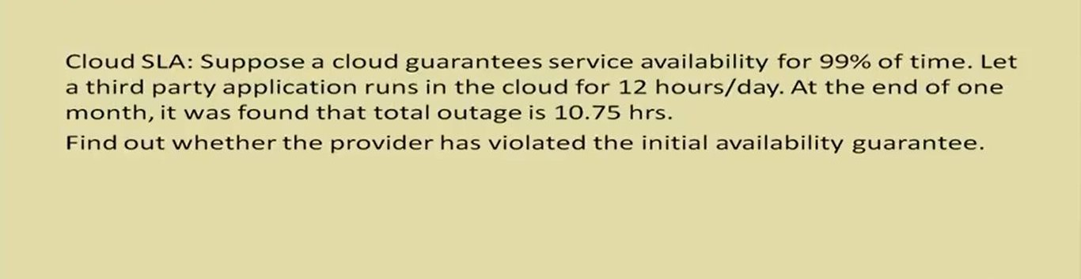
Problem #1

Slide 21
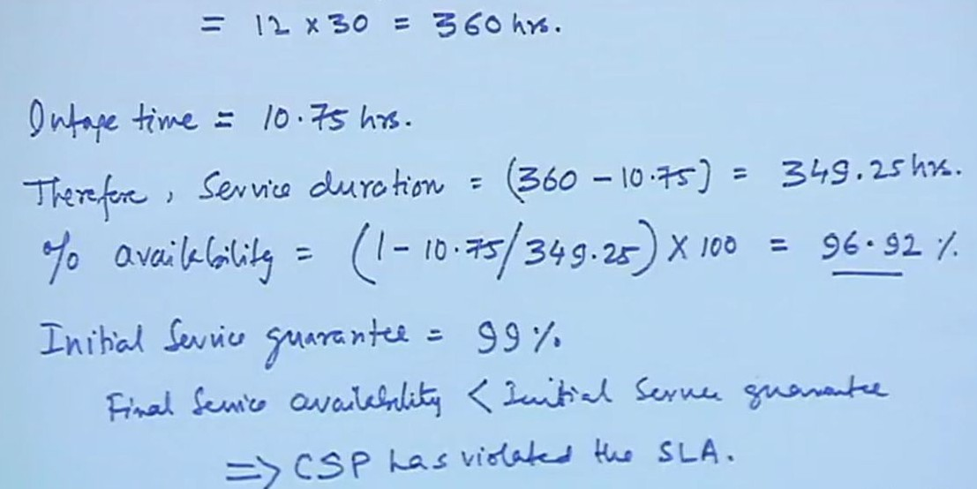
Solution

Slide 22
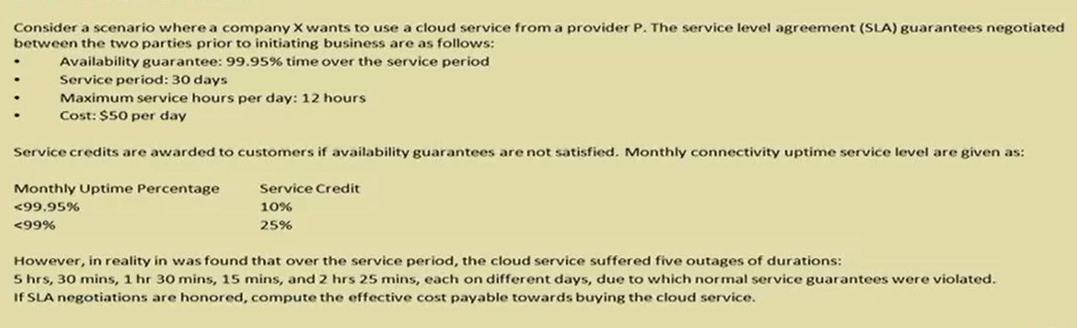
Problem #2

Slide 23
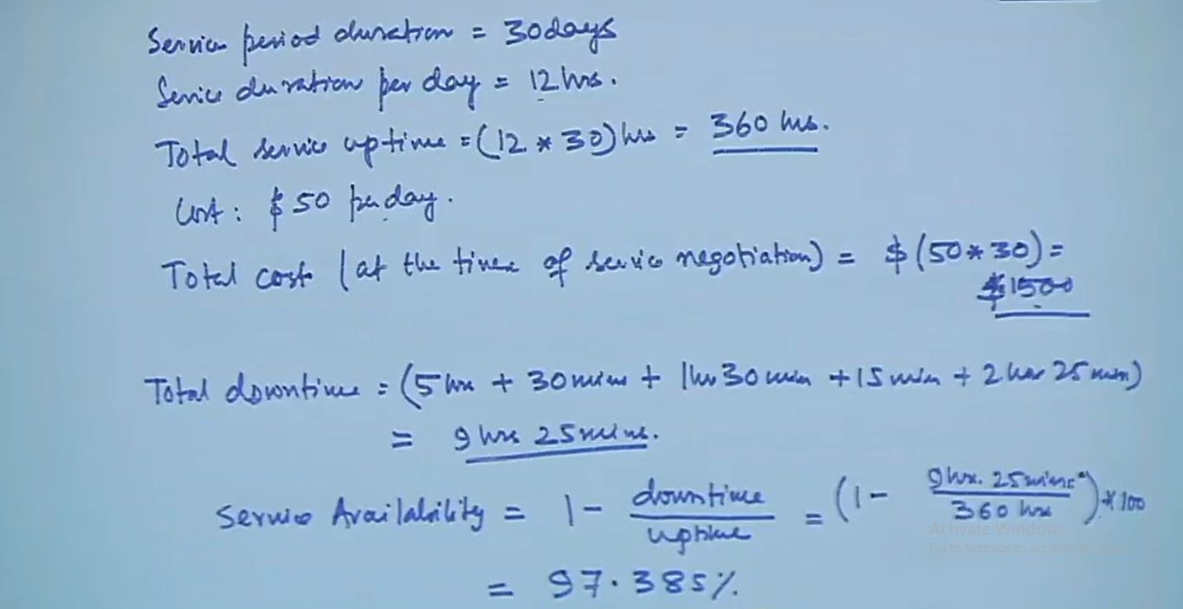
Solution

Slide 24
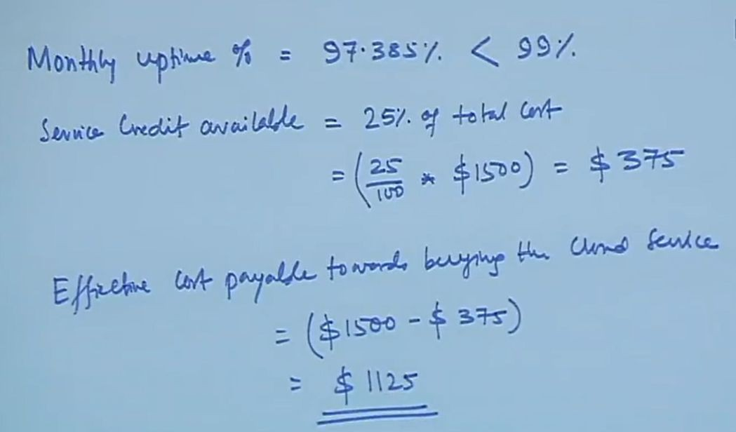
Solution

Slide 25
Thank you!
Any Questions???

